Slide 1
SAN JOSE DELMONTE BULACAN
THE NEXT SUPER CITY IN PHILIPPINES San Jose del Monte is a suburban city in the province of Bulacan, Philippines. It is bordered by Caloocan and Quezon City in the south; by Rodriguez, Rizal, in the east; Santa Maria and Marilao, both of Bulacan, in the west; and Norzagaray San Jose del Monte has experienced major economic growth, evidenced by the presence of major commercial banks, fast food chain outlets, real estates, and wide coverage of landline and cellular phone service
San Jose del Monte is easily accessible with a direct connection to NLEX and can be reached by all types of vehicles through Quirino Highway. In the future, it will be less than 10 minutes away from the upcoming MRT 7.
SAN JOSE DEL MONTE BULACAN The First City of Bulacan
Mayor: Reynaldo S. San Pedro Vice Mayor: Eduardo S. Roquero Jr.

Slide 2
UPCOMING AND ON GOING CONSTRUCTION IN SAN JOSE DELMONTE BULACAN

Slide 3
Altaraza Town Center San Jose Del Monte City, Bulacan
Altaraza Town Center
Is an exciting township just 15 minutes from SM Fairvew and Fairview Terraces and a short hop to the planned MRT-7 line. Featuring a commercial center “The District”, a UPMC hospital and various retail and BPO facilities, this Ayala Land development is blessed with the nature-rich environment of San Jose Del Monte City in Bulacan and a picturesque terrain.

Slide 4
AMAIA STEP ALTARAZA midrise condo
BPO/CALLCENTER
UPMC
HOSPITAL

Slide 5
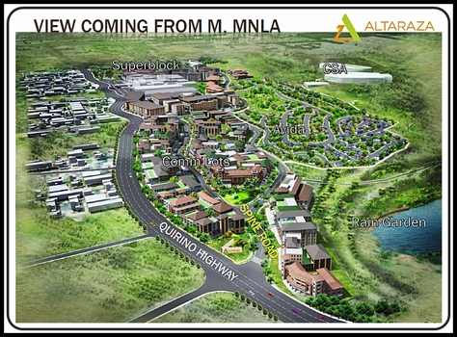
AVIDA SETTING
RAIN GARDEN

Slide 6
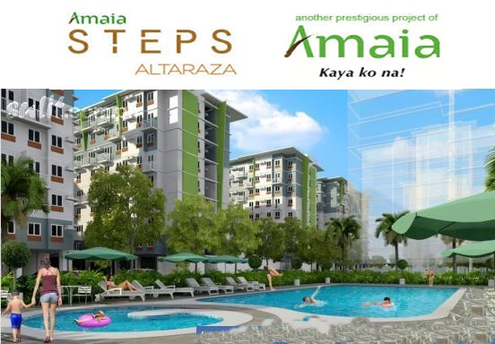
HOUSE AND LOT & CONDO
SITUATED WITHIN THE HEART OF
ALTARAZA TOWN CENTER
CONDOMINIUM midrise
Starting Price 4.6M – 6M
Starting Price 1.4M – 3M

Slide 7
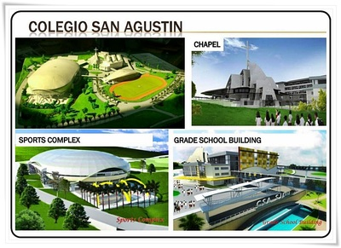
Colegio San Agustin is also set to construct a 20-hectare campus offering primary to tertiary education within the complex. There will also be a church and a sports stadium.

Slide 8
North Avenue
Quezon Memorial
University Avenue
Tandang Sora
Don Antonio
Batasan
Manggahan
Doña Carmen
Regalado Avenue
Mindanao Avenue
Quirino
Sacred Heart
Tala
Araneta ave SJDM BULCAN( proposed intermodal transportation terminal in San Jose del Monte, Bulacan.

Slide 9
C6 ROAD
The C-6 will connect SLEX and NLEX through the ff. route: --SLEX--Taguig--Angono, Rizal--Antipolo, Rizal--San Mateo, Rizal--Rodriguez(Montalban), -San Jose del Monte, Bulacan--NLEX

Slide 10
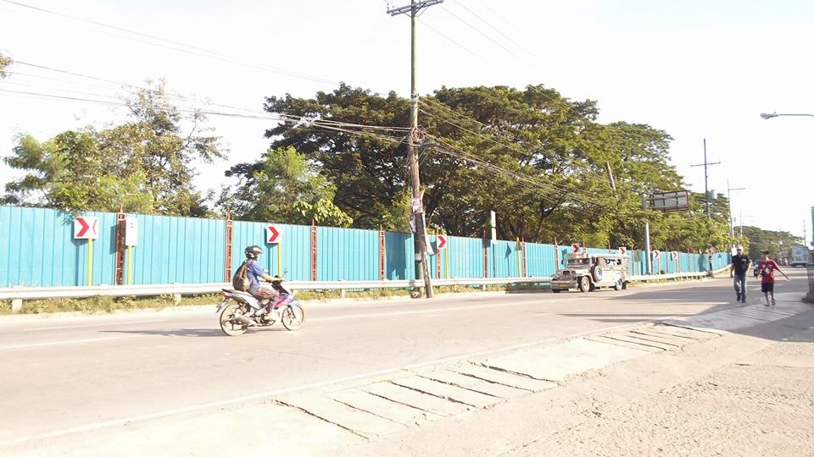
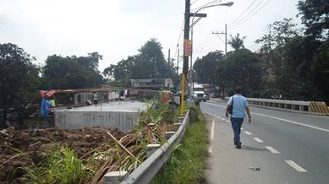
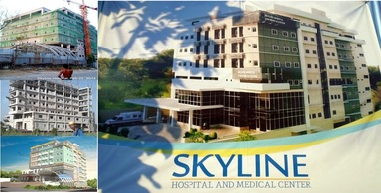
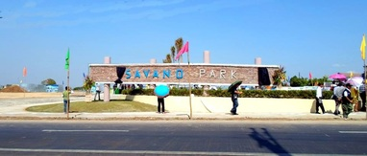
SM Regional Mall – which would be the biggest SM Mall in Bulacan
ALAT BRIDGE
SKYLINE HOSPITAL
SAVANO PARK

Slide 11
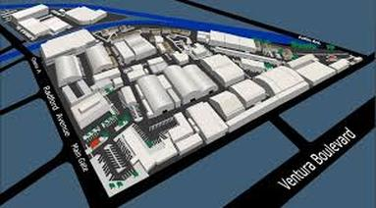
ABS-CBN STATE OF THE ART SOUND STAGE
Media company ABS-CBN Corp. is set to open the first of its modern soundstages in San Jose del Monte City, Bulacan in the first quarter of 2015.
The company earlier acquired a 15-hectare property in San Jose del Monte as the site for soundstages, or sound-proof buildings that are designed for shooting TV shows and films.
Aside from soundstages, ABS-CBN will also be constructing backlots, areas adjacent to a soundstage that will enable them to shoot exterior or outdoor scenes, like a slum area or a street in New York City, without traveling to far-off places.

Slide 12
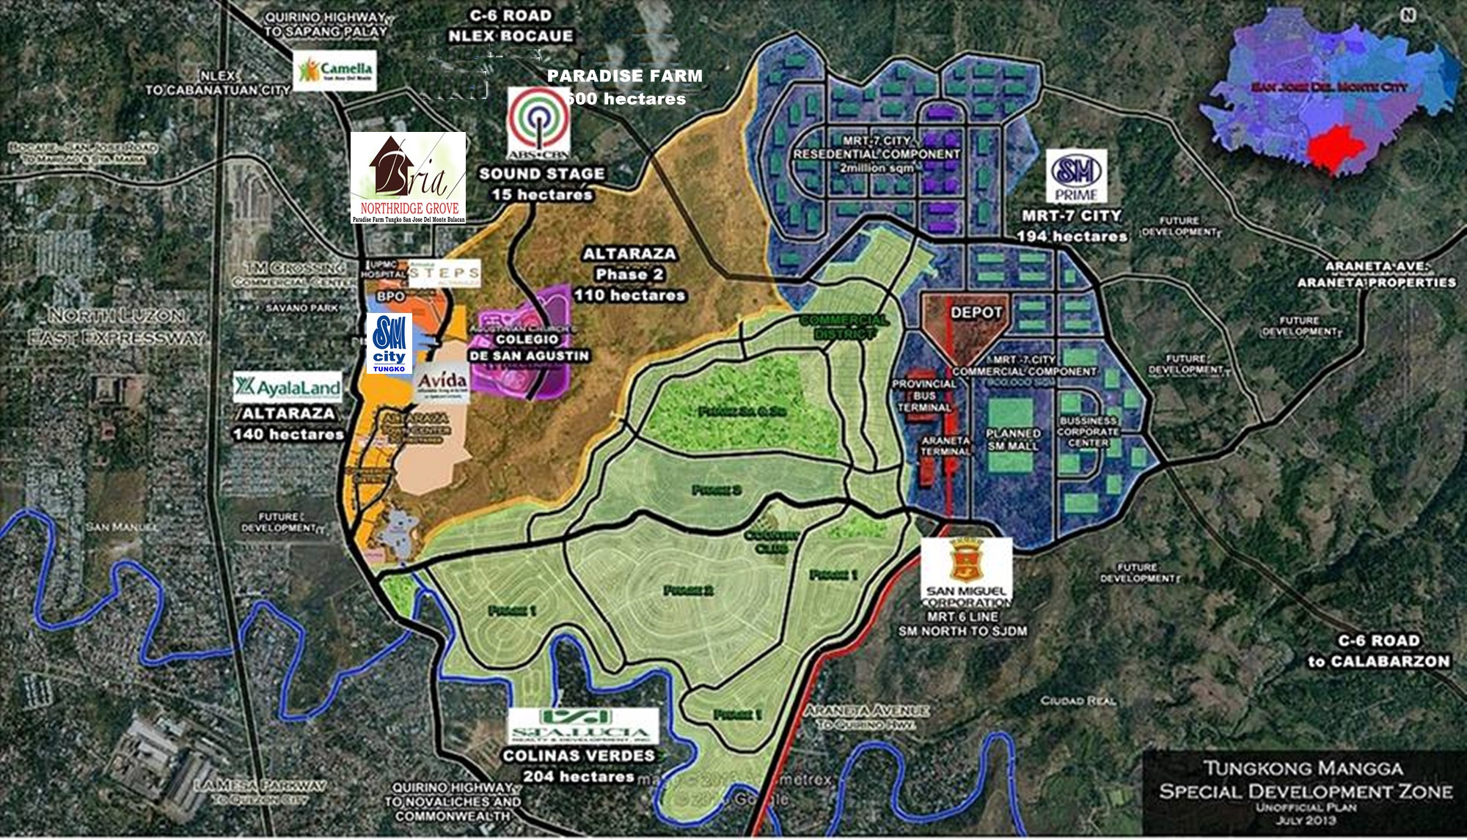
TUNGKO MANGGA SPECIAL DEVELOPMENT ZONE
MRT 7 STATION
MRT 7 STATION

Slide 13
REAL ESTATE PROJECT
CITY OF
SAN JOSE DELMONTE BULACAN

Slide 14
